Slide 1


9 paskaita. Projektų kūrimas, modulių import
1 LYGIS
2023
Aurimas Aleksandras Nausėdas
Notes:
Siandien mes pakalbesime apie projektu kurima, moduliu importavima ir ()

Slide 2
9 paskaita. Projekto kūrimas, modulių import
Šiandien išmoksite
01
Kaip importuoti savo sukurtus modulius
02
Kaip importuoti standartinius modulius
03
Kaip importuoti tik tuos dalykus kurių reikia
Notes:
Apzvelgsime kaip importuoti sukurtus modulius, standartinius modelius ir kaip importuoti tik to ko reikia ir pradekime angliskai nuo ()

Slide 3
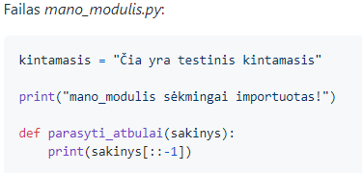
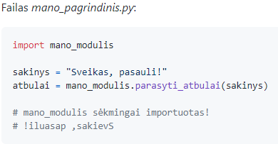
9 paskaita. Projekto kūrimas, modulių import
Kaip sukurti projektą su daug katalogų ir failų
Projekte turime du .py failus:
mano_modulis.py
mano_pagrindinis.py
1
Notes:
One of the crucial skills in programming and software development is the ability to effectively structure and organize your code. This organization becomes especially critical as projects grow larger and more complex. By creating multiple folders and files, we can ensure that our code remains modular, easy to understand, and maintain.
In Python, these separate files are often referred to as modules. A module is a file containing Python definitions and statements. The file name is the module name with the suffix .py added. Within a module, the module’s name (as a string) is available as the value of the global variable __name__.
Now, let's delve into the practical aspect of creating a Python project with multiple files.
Step 1: Create a Project Folder
First, you need to create a project folder. This will be the root directory of your project. Let's name it python_project.
Step 2: Create Python Files
Within this project folder, create two Python files: mano_modulis.py and mano_pagrindinis.py. These will be your Python modules.
mano_modulis.py
The first file, mano_modulis.py, contains a variable declaration, a print statement, and a function definition. The contents of the file are as follows:
kintamasis = "Čia yra testinis kintamasis" print("mano_modulis sėkmingai importuotas!") def parasyti_atbulai(sakinys): print(sakinys[::-1])
Here, kintamasis is a variable that holds a string. The print statement confirms that the module has been successfully imported. The function parasyti_atbulai takes in a sentence (sakinys) as an argument and prints the sentence in reverse order. The [::-1] slice is a common Python idiom for reversing a string.
mano_pagrindinis.py
The second file, mano_pagrindinis.py, imports the mano_modulis.py module and calls the function defined in that module. The contents of the file are as follows:
import mano_modulis sakinys = "Sveikas, pasauli!" atbulai = mano_modulis.parasyti_atbulai(sakinys)
Here, import mano_modulis is importing the mano_modulis.py module. The variable sakinys is assigned a string, and then the parasyti_atbulai function from mano_modulis is called with sakinys as the argument.
Step 3: Running the Code
To run the code, you would execute the mano_pagrindinis.py file. Python will import the mano_modulis.py module, print the import confirmation statement, and then call the parasyti_atbulai function to print the sentence in reverse order.
Step 4: Adding More Files and Folders
As your project grows, you may need to add more Python files or even folders. You can use the same principles outlined above. When creating new folders, it's important to add an __init__.py file to them. This file can be empty,but it indicates to Python that the directory should be treated like a Python package. This allows you to import modules from this directory using the directory's name.
For instance, suppose you have a directory named utils and inside this directory, you have a Python file named helpers.py. If you want to import a function named helper_function from helpers.py, you would do so like this:
from utils.helpers import helper_function
Step 5: Organizing Your Project
As your project grows, you may want to organize your Python files into different directories based on their functionality. For example, you could have a directory for utility functions, another for database interactions, and another for your main application logic.
Each of these directories would have its own __init__.py file and can contain as many Python files as needed. The goal here is to create a structure where each file and directory has a clear, self-explanatory purpose. This makes your project easier to navigate and maintain, especially for other developers.
Step 6: Documenting Your Project
In addition to writing code, it's crucial to document your project. This includes writing descriptive comments in your code, maintaining a README file that describes the project and how to run it, and possibly even using a tool like Sphinx to generate full-fledged documentation.
In the case of the given Python code, each file has a specific purpose, which would be described in comments or in the README. For example,
mano_modulis.py contains a function that reverses strings, while mano_pagrindinis.py is a main file that uses this function.
Conclusion
Creating a Python project with many folders and files isn't just about writing code; it's also about structuring and organizing that code in a way that makes it clear and easy to understand. By properly organizing your project, you make it easier to maintain and expand in the future, and you make it easier for others to understand and contribute to your project.

Slide 4
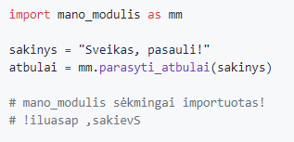
9 paskaita. Projekto kūrimas, modulių import
Kaip Importuoti modulį
2
Notes:
Introduction
In Python, a module is a file consisting of Python code. A module can define functions, classes, and variables, and it can also include runnable code.
Importing modules in Python allows you to access and use the functions, classes, and variables defined in that module, making code reuse possible and the program more organized.
What Does It Mean to Import a Module?
When you import a module, what you're essentially doing is loading that module's code into memory so that your program can access and use it. This is done using the import keyword in Python.
How to Import a Module
There are several ways to import a module in Python:
Import the entire module: You can import a module using the import keyword followed by the name of the module. For example, import mano_modulis will import the entire mano_modulis module.
Import the module with an alias: Sometimes, for the sake of brevity or to avoid naming conflicts, it's helpful to give a module a shorter alias. This is done using the as keyword. For example, import mano_modulis as mm imports the mano_modulis module, but allows you to refer to it as mm in your code.
The alias provides a way of using the module in your code without having to refer to it by its full name. For example, instead of calling a function as mano_modulis.parasyti_atbulai(sakinys), you can now call it as mm.parasyti_atbulai(sakinys).
Here is the code snippet given:
import mano_modulis as mm sakinys = "Sveikas, pasauli!" atbulai = mm.parasyti_atbulai(sakinys)
In this code, mano_modulis is imported as mm, a string is assigned to the variable sakinys, and then the parasyti_atbulai function from mano_modulis is called with sakinys as the argument using the alias mm.
Import specific items from a module: You can also import specific functions, classes, or variables from a module, rather than importing the entire module. This is done using the from ... import ... syntax. For example, from mano_modulis import parasyti_atbulai would import only the parasyti_atbulai function from the mano_modulis module.
This approach can make your code cleaner and easier to read, as you won't need to use the module name or alias when calling the function. However, it can also lead to naming conflicts if different modules have functions or variables with the same name.
Where Does Python Look for Modules?
When you import a module, Python searches for the module in the following locations, in this order:
The directory of the input script (or the current directory).
The directories listed in the PYTHONPATH environment variable, if it is set.
The standard library directories.
The contents of any .pth files, if they exist.
The site-packages directory (where third-party packages are installed).
If the module is found in one of these locations, Python will import it. If not, Python will raise an ImportError.
Conclusion
Understanding how to import modules in Python is crucial for any Python programmer. By importing modules, you can reuse code from different modules, making your programs more modular and easier to understand and maintain.

Slide 5
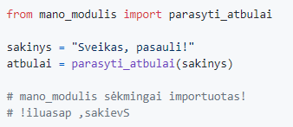
9 paskaita. Projekto kūrimas, modulių import
Importuoti tik funkciją
3
Notes:
Introduction
Python's modular design philosophy encourages the creation of reusable code. This is achieved by bundling related code into modules and packages, which can then be imported and used in other programs. Importing specific functions from a module is a commonly used feature in Python that enables this reuse and can help make your code more concise and readable.
Importing Specific Functions
To import a specific function from a module, you use the from ... import ... syntax. For example, from mano_modulis import parasyti_atbulai imports only the parasyti_atbulai function from the mano_modulis module. Once this is done, you can use the parasyti_atbulai function in your code without having to prefix it with the module name.
Here is the given code snippet:
from mano_modulis import parasyti_atbulai sakinys = "Sveikas, pasauli!" atbulai = parasyti_atbulai(sakinys)
In this code, the function parasyti_atbulai is imported from mano_modulis. Then, a string is assigned to the variable sakinys, and the parasyti_atbulai function is called with sakinys as the argument. Notice how we didn't have to use the module name to call the function - we just used its name directly.
Importing Multiple Functions
You can import multiple functions from a module by separating the function names with commas:
from mano_modulis import function1, function2, function3
Importing All Functions
To import all functions from a module, you can use the * wildcard:
from mano_modulis import *
This will import all functions, classes, and variables defined in the module. However, this practice is generally discouraged, as it can lead to naming conflicts and makes it unclear which module a particular function or variable came from.
Importing Functions with Aliases
You can also give imported functions an alias, similar to how we can give imported modules an alias. This can be done when the function name is long or if there is a naming conflict with another function in your code.
For example, if you have another function named parasyti_atbulai in your code, you can import the parasyti_atbulai from mano_modulis with an alias to avoid confusion:
from mano_modulis import parasyti_atbulai as pa
You can then call this function using its alias:
sakinys = "Sveikas, pasauli!" atbulai = pa(sakinys)
Conclusion
Importing specific functions from modules in Python is a useful technique that can help make your code cleaner and more readable. It also promotes code reuse, one of the key philosophies of Python and programming in general. Understanding how to import functions is an important skill in Python programming.

Slide 6
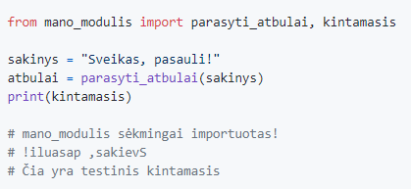
9 paskaita. Projekto kūrimas, modulių import
Importuoti daugiau
4
Notes:
Introduction
In Python, you can import multiple items from a module by including them in the import statement, separated by commas. This approach is often used when you want to use a few specific functions, classes, or variables from a module without importing the entire module.
Importing Multiple Items
The syntax for importing multiple items from a module is:
from module_name import item1, item2, item3
Here, module_name is the name of the module you're importing from, and item1, item2, and item3 are the names of the items you're importing.
In your provided code snippet:
from mano_modulis import parasyti_atbulai, kintamasis sakinys = "Sveikas, pasauli!" atbulai = parasyti_atbulai(sakinys) print(kintamasis)
The parasyti_atbulai function and kintamasis variable are imported from the mano_modulis module. The parasyti_atbulai function is then called with sakinys as an argument, and the kintamasis variable is printed.
Considerations
While importing specific items from a module can make your code cleaner and more efficient, it does come with some risks. One is the possibility of name clashes. If the item you're importing from a module has the same name as an item in your script, the imported item will overwrite the one in your script.
Importing All Items
If you want to import all items from a module, you can use the * wildcard:
from module_name import *
However, this practice is generally discouraged because it can lead to name clashes and make your code less clear. It's usually better to import only the items you need or to import the entire module and use dot notation to access its items.
Conclusion
Importing multiple items from a module is a useful feature in Python that can help make your code more efficient and easier to read. However, it's important to be aware of the risks of name clashes and to strive for clear, easy-to-understand code. As always in Python, readability counts!

Slide 7
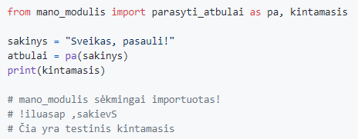
9 paskaita. Projekto kūrimas, modulių import
Importuoti vieną jų kaip trumpinį
5
Notes:
When importing items from a module in Python, you can assign them an alias, or a short name, that can be used in place of the full item name in your code. This is especially useful when the names of the items you're importing are long or if you want to avoid naming conflicts with other items in your code.
Syntax for Importing with an Alias
The syntax to import an item with an alias is:
from module_name import item_name as alias_name
In this case, module_name is the name of the module, item_name is the name of the item you're importing from the module, and alias_name is the short name that you want to use for the item in your code.
You can also import multiple items with aliases at once:
from module_name import item1 as alias1, item2 as alias2
Example
In your provided code snippet:
from mano_modulis import parasyti_atbulai as pa, kintamasis sakinys = "Sveikas, pasauli!" atbulai = pa(sakinys) print(kintamasis)
The parasyti_atbulai function is imported from the mano_modulis module with the alias pa, and the kintamasis variable is also imported. Then, the pa function is called with sakinys as an argument, and the kintamasis variable is printed.
Notice that instead of using parasyti_atbulai(sakinys), we used pa(sakinys), which is clearer and more concise.
Benefits and Considerations
Using aliases can make your code cleaner and more readable, especially when working with modules that have long or complicated names. However, it's important to choose meaningful alias names that make sense in the context of your code. An alias that is too short or non-descriptive can make your code harder to understand.
Additionally, be mindful of potential naming conflicts. If you import an item with an alias that is the same as a built-in Python function or variable, you could unintentionally overwrite the built-in item.
Conclusion
Importing items with an alias is a useful tool in Python that allows you to write cleaner, more readable code. By understanding and properly using this feature, you can enhance the structure and legibility of your Python programs.

Slide 8
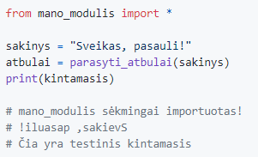
9 paskaita. Projekto kūrimas, modulių import
Importuoti viską
6
Notes:
Introduction
In Python, the * wildcard symbol can be used to import all items from a module, including functions, classes, and variables. This technique allows you to use these items directly in your script without having to prefix them with the module name.
Syntax for Importing Everything
The syntax to import everything from a module is:
from module_name import *
In this syntax, module_name is the name of the module you're importing from.
Example
Let's consider the given code snippet:
from mano_modulis import * sakinys = "Sveikas, pasauli!" atbulai = parasyti_atbulai(sakinys) print(kintamasis)
Here, from mano_modulis import * is used to import all items from the mano_modulis module. Then, the parasyti_atbulai function and kintamasis variable, which are defined in mano_modulis, are used directly in the script without needing to be prefixed with mano_modulis..
Considerations
While importing everything from a module might seem convenient, it's generally not a recommended practice for a few reasons:
Namespace pollution: Importing everything from a module can introduce many new names into your script, potentially obscuring names that you have defined.
Reduced readability: When you import everything, it's not immediately clear where a particular function or variable comes from, which can make your code harder to read and debug.
Name clashes: If a function or variable in the module has the same name as one in your script, it will overwrite the one in your script, which can lead to unexpected behavior.
Because of these issues, it's generally better to import only the specific items you need or to import the module itself and use the module name as a prefix when accessing its items.
Conclusion
Importing everything from a module in Python can be a quick way to access all of a module's contents, but it should be used judiciously due to potential issues with namespace pollution, reduced readability, and name clashes. It's often better to import only what you need or to use the module name as a prefix when accessing its items, which leads to clearer, more maintainable code.

Slide 9
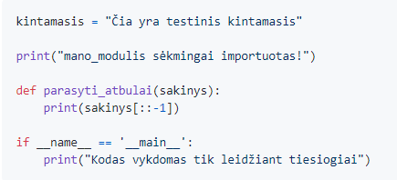
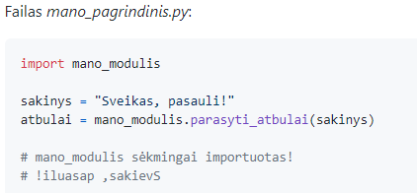
9 paskaita. Projekto kūrimas, modulių import
Kad kodas būtų paleidžiamas tik tiesiogiai paleidžiant failą
7
Notes:
Introduction
In Python, __name__ is a special built-in variable. When a Python file is run directly, __name__ is set to "__main__". However, when the same file is imported as a module into another script, __name__ is set to the module's name.
We can use this mechanism to control the execution of our code depending on whether the file is being run directly or imported as a module.
Syntax
The syntax for this idiom is:
if __name__ == "__main__": # code to be run only when the script is run directly
Example
Let's consider your provided code snippet:
kintamasis = "Čia yra testinis kintamasis" print("mano_modulis sėkmingai importuotas!") def parasyti_atbulai(sakinys): print(sakinys[::-1]) if __name__ == "__main__": print("Kodas vykdomas tik leidžiant tiesiogiai")
In this code, the if __name__ == "__main__": block will only execute if the script is run directly. If the script is imported as a module into another script, this block will not execute.
In your main file, you then have:
import mano_modulis sakinys = "Sveikas, pasauli!" atbulai = mano_modulis.parasyti_atbulai(sakinys)
In this script, mano_modulis is imported, and its parasyti_atbulai function is used. However, the print statement inside the if __name__ == "__main__": block in mano_modulis is not executed because mano_modulis is not being run directly – it's being imported as a module.
Benefits and Uses
The __name__ == "__main__" idiom is often used to separate code that should only run when the script is run directly (such as testing code or demo examples) from code that should always run (like function and class definitions).
It's a good practice to use this idiom to make your Python scripts reusable as modules and directly executable as scripts.
Conclusion
The __name__ == "__main__" idiom in Python is a powerful tool for controlling the execution of your code. By understanding and using this feature, you can write Python scripts that are both reusable as modules and directly executable as standalone programs. This leads to more modular, versatile, and maintainable code.

Slide 10
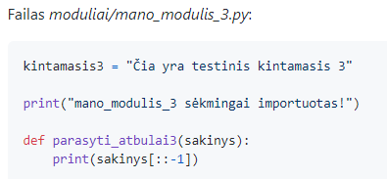
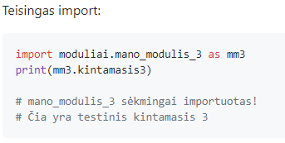
9 paskaita. Projekto kūrimas, modulių import
Importuoti modulį iš kito katalogo
Projekte turime du .py failus, taip pat katalogą su dar vienu .py failu:
mano_modulis.py
mano_pagrindinis.py
moduliai/mano_modulis_3.py
8
Notes:
Introduction
Python modules can reside in different directories. As long as Python knows where to find these modules, you can import them just like how you'd import a module that's in the same directory as your script.
When you import a module, Python searches for the module in a list of directories defined in sys.path. This list includes the current directory, the site-packages directory, and other installation-dependent default paths. You can also modify sys.path during runtime to include additional directories where
Python should look for modules, but this is generally not recommended as it can lead to code that is hard to reproduce on a different machine or environment.
Importing a Module from a Subdirectory
If the module you want to import resides in a subdirectory of the current directory, you can import it using a dot (.) to separate the directory name and the module name.
In your provided code:
import moduliai.mano_modulis_3 as mm3 print(mm3.kintamasis3)
Here, moduliai.mano_modulis_3 is the module you're importing. The directory moduliai is a subdirectory of the directory where your script is running, and mano_modulis_3 is the Python file (i.e., module) that resides in this subdirectory.
You use the as keyword to give the module the alias mm3, which is then used to access the kintamasis3 variable defined in the module.
Please note, for Python to recognize a directory as a package (and hence be able to import modules from it), it needs to contain an __init__.py file. This file can be empty but it must be present in the directory.
Conclusion
Organizing your Python code into different modules that reside in different directories can help improve the structure and maintainability of your projects.
By understanding how to import modules from different directories, you can leverage the power of Python's modular programming to build more complex, well-organized applications.

Slide 11
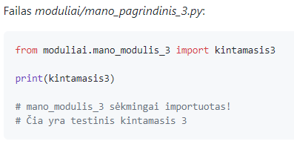
9 paskaita. Projekto kūrimas, modulių import
Kaip importuoti modulius iš to paties katalogo (absolute import)
9
Notes:
Introduction
Python provides two types of imports: absolute and relative. Absolute imports involve full paths to the resources being imported, starting from the project's root directory. On the other hand, relative imports involve paths relative to the current module, and they use dots to indicate the current directory and parent directory.
Absolute imports are generally preferred because they are clear and straightforward. The full path to the module is given, which makes it easy to see exactly where the imported resources are located. This clarity is especially helpful in larger projects with many modules spread across different directories.
Absolute Imports in Python
An absolute import specifies the complete path (starting from the project's root directory) to the module or resource that you want to import. The syntax is:
from some_package.some_module import some_function
In this syntax, some_package.some_module is the full path to the module, and some_function is the function (or class, or variable) you're importing from that module.
Example
Let's consider your provided code snippet:
from moduliai.mano_modulis_3 import kintamasis3 print(kintamasis3)
In this code, moduliai.mano_modulis_3 is the full path to the module, starting from the project's root directory. kintamasis3 is the variable you're importing from that module.
Even though the mano_pagrindinis_3.py file is located in the same directory as mano_modulis_3.py, the full path to mano_modulis_3.py is used in the import statement. This is an absolute import.
Considerations
The primary advantage of absolute imports is their clarity. By using the complete path to the module, it's immediately obvious where the imported resources are located. This can make the code easier to read and understand, especially in larger projects.
However, absolute imports can be more verbose than relative imports, especially when dealing with deeply nested packages. They can also be more difficult to move around, as moving a module to a different location in the project would require updating all absolute imports of that module.
Conclusion
In conclusion, absolute imports are a clear and straightforward way to import resources in Python. By specifying the full path to the module or resource, absolute imports make it easy to see exactly where the imported items are located. This can greatly improve the readability and maintainability of your code, especially in larger Python projects.

Slide 12
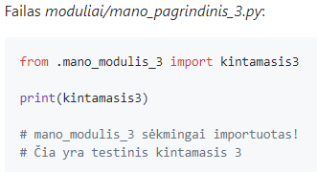
9 paskaita. Projekto kūrimas, modulių import
Kitas importavimo iš to paties katalogo būdas (relative import)
. – tame pačiame pakete (kataloge)
.. – aukščiau esančiame pakete (kataloge)
10
Notes:
Introduction
Relative imports in Python allow you to import modules in relation to the current module's path. This can be handy in cases where the exact structure of the project might change, or the project has a deeply nested structure, and you want to avoid writing lengthy import statements.
Relative Imports in Python
Relative imports use leading dots to indicate the current and parent modules in the system. A single leading dot indicates a relative import to the current directory, two dots would mean the parent directory, and so forth. The syntax for relative import is:
from .some_module import some_function
In this syntax, .some_module means that the some_module is in the same directory as the current module, and some_function is the function (or class, or variable) you're importing from that module.
Example
Consider your provided code snippet:
from .mano_modulis_3 import kintamasis3 print(kintamasis3)
Here, .mano_modulis_3 is the relative path to the module from the current file (mano_pagrindinis_3.py). The single dot (.) before mano_modulis_3 indicates that mano_modulis_3.py is in the same directory as the current script. kintamasis3 is the variable that you're importing from that module.
Considerations
Relative imports can be less verbose than absolute imports when dealing with deeply nested packages. However, they can be less clear since the import path does not specify the full path from the project root. This can make the code harder to understand for someone who is not familiar with the project structure.
Another thing to note is that relative imports are based on the name of the current module. Since the name of the main module is always "__main__",
Python will not be able to determine the location of the main module relative to the other modules if it is run directly. This means that relative imports can lead to errors if the script is intended to be run directly.
Conclusion
Relative imports are a way of importing resources in Python relative to the current module's path. They can be a convenient way to keep import statements concise in projects with deeply nested structures. However, they can make the code harder to understand and can cause errors if used in scripts that are meant to be run directly. As such, it's crucial to understand the trade-offs and use relative imports judiciously in your Python projects.

Slide 13
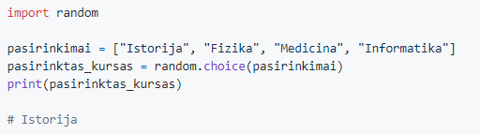
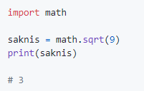
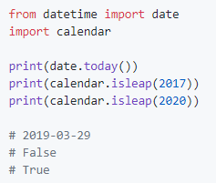
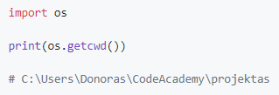
9 paskaita. Projekto kūrimas, modulių import
Importavimas iš standartinės Python bibliotekos
11
Notes:
One of Python's key advantages as a programming language is its extensive standard library. The standard library contains a vast array of modules that provide handy functions and features, ranging from file I/O, system calls, and even interfaces for email and web servers. It's sometimes referred to as the "batteries included" philosophy, which means Python comes with a rich set of useful tools right out of the box.
Python's Standard Library
Let's go over a few examples from the provided code snippets to illustrate the power and versatility of Python's standard library:
Random Module: The random module is used to generate pseudo-random numbers for various distributions. In your code: import random pasirinkimai = ["Istorija", "Fizika", "Medicina", "Informatika"] pasirinktas_kursas = random.choice(pasirinkimai) print(pasirinktas_kursas) Here, you're using the random.choice function to randomly select an element from a list. This could be used in a variety of applications, such as simulating randomness in a game or selecting a random item from a list.
Math Module: The math module provides mathematical functions. In this code: import math saknis = math.sqrt(9) print(saknis) You're using the math.sqrt function to calculate the square root of a number. The math module also provides functions for trigonometric calculations, complex numbers, and more.
Datetime and Calendar Modules: The datetime and calendar modules are used for manipulating dates and times. In this code: from datetime import date import calendar print(date.today()) print(calendar.isleap(2017)) print(calendar.isleap(2020)) You're using date.today to get the current date and calendar.isleap to check if a given year is a leap year or not. These modules provide a wide range of functions to work with dates and times.
OS Module: The os module provides functions for interacting with the operating system: import os print(os.getcwd()) Here, you're using os.getcwd to get the current working directory. The os module also provides functions to manipulate the file system, such as renaming and deleting files, iterating over directories, and more.
Conclusion
In conclusion, Python's standard library is a powerful tool that can greatly speed up your development process by providing pre-built modules for a wide range of tasks. By effectively using the standard library, you can avoid "reinventing the wheel" and focus on the unique aspects of your project. As you continue to learn Python, I encourage you to explore the standard library and familiarize yourself with the modules that you find most useful.

Slide 14
9 paskaita. Projekto kūrimas, modulių import
Užduotis nr. 1
Python faile padaryti šiuos veiksmus (atskirai, ne iškart):
Importuoti modulį datetime. Atsispausdinti šiandienos datą ir laiką kartu, tik datą (date.today()) bei tik laiką (.now().time()).
Iš paketo datetime importuoti modulį date. Atsispausdinti šiandienos datą.
Iš paketo datetime importuoti modulį date kaip data (as data). Atsispausdinti šiandienos datą.
12

Slide 15
9 paskaita. Projekto kūrimas, modulių import
Užduotis nr. 2
Sukurti naują projektą (PyCharm programoje) Jame sukurti failą modulis.py, kuriame:
Kintamajam kintamasis priskirti reikšmę „Čia yra kintamasis“
Sukurti funkciją funkcija(), kuri atspausdina „Čia yra funkcija“.
Sukurti klasę Objektas, kurį iniciavus atspausdina „Čia yra klasė“.
Sukurti failą main.py, kuriame:
Importuoti modulį modulis
Atspausdinti importuotą kintamąjį kintamasis
Paleisti importuotą funkciją funkcija()
Inicijuoti importuotos klasės Objektas() objektą
13

Slide 16
9 paskaita. Projekto kūrimas, modulių import
Užduotis nr. 3
Sukurti naują projektą Mokymas
Projekto kataloge sukurti katalogą modules
Kataloge modules sukurti failą kursas.py
Faile kursas.py sukurti objekto klasę Kursas, kuri turėtų savybes pavadinimas, destytojas, trukme, taip pat metodą destyti(), kuris spausdintų „Vyksta mokymas!“
Kataloge modules sukurti antrą failą python_kursas.py
Faile python_kursas.py sukurti objekto klasę PythonKursas, kuri paveldėtų viską iš klasės Kursas, bei perrašytų metodą destyti() taip, kad jis spausdintų „Vyksta programavimas!“
Pagrindiniame projekto kataloge sukurti failą main.py
Faile main.py importuoti PythonKursas modulį (failą)
Faile main.py inicijuoti Kursas objektą su norimomis savybėmis
Faile main.py inicijuoti PythonKursas objektą su norimomis savybėmis
Paleisti abiejų objektų metodą destyti()
14

Slide 17
9 paskaita. Projekto kūrimas, modulių import
Užduotis nr. 4
Perdaryti biudžeto programą su klasėmis (iš 6 paskaitos) taip, kad visos klasės būtų skirtinguose failuose.
15

Slide 18
9 paskaita. Projekto kūrimas, modulių import
Namų darbas
Užbaigti klasėje nepadarytas užduotis
16

Slide 19
9 paskaita. Projekto kūrimas, modulių import
Išspręsti paskaitos uždaviniai (įkelti pirmadienį)
https://github.com/aurimas13/Python-Beginner-Course/tree/main/Programs
The Python Standard Library
https://docs.python.org/3/library/
Visi standartinės bibliotekos moduliai
Naudinga informacija

